Slide 1
CSE 145: Brilliant Pad Poo Vision
Oral Project Update

Slide 2
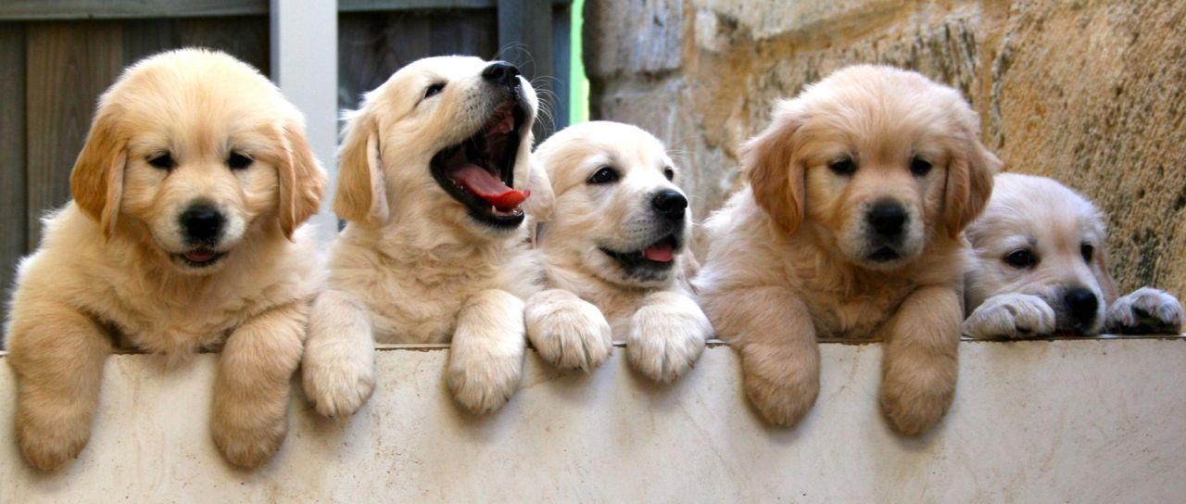
You can’t say no to these guys
Notes:
These guys, no matter how adorable and cuddly they are, they are still a handful.

Slide 3
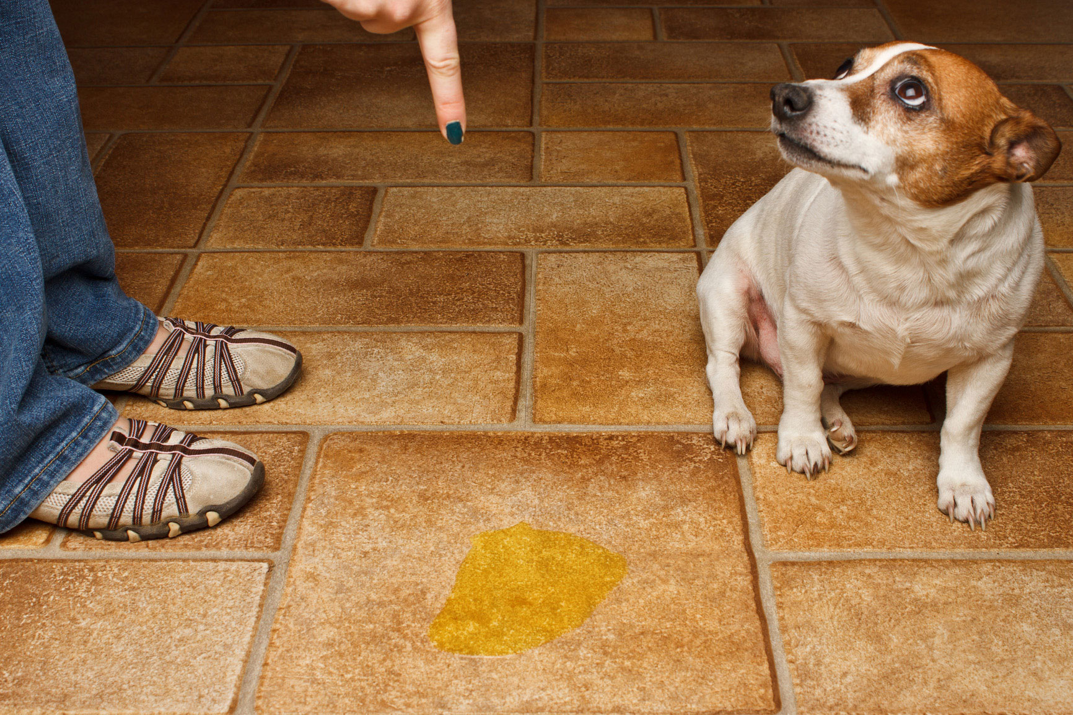

They Can Be A Hassle
Notes:
Food
Water
Walk
Love
Lol thesis: Dogs use the restroom too, but we don’t want to clean it

Slide 4
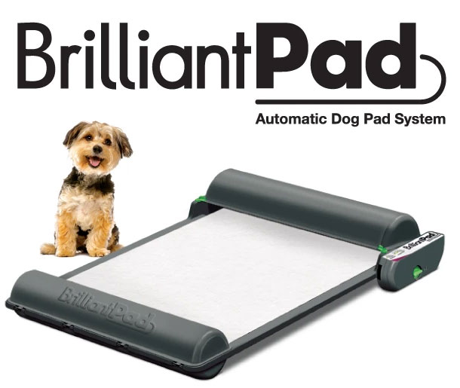
Notes:
Luckily there is Brilliant pad
Brilliant pad is an automated dog potty pad
How brilliant pad works.
Very simple. All of the electronics kept in a small compartment.
Everything else is plastic.
Automated
Senses the dog

Slide 5
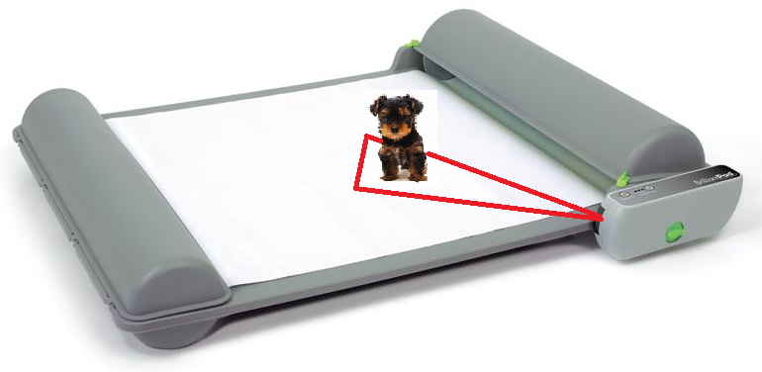
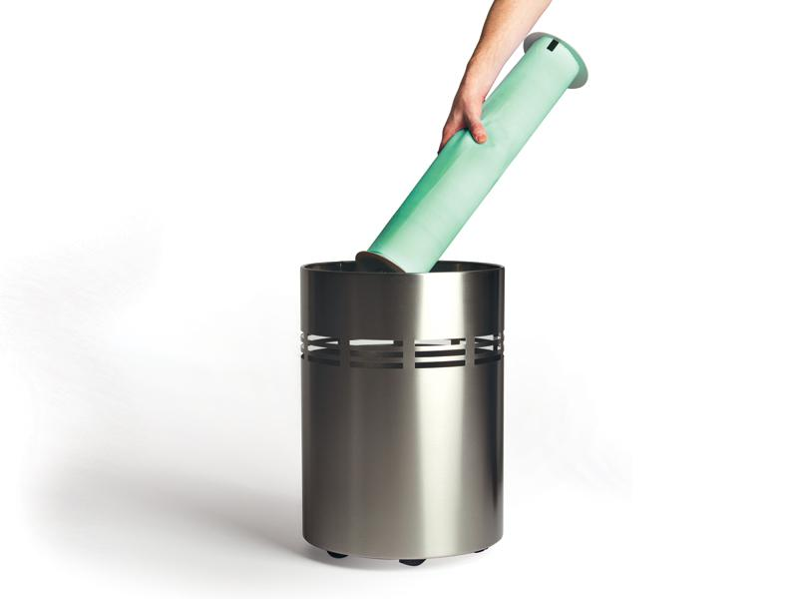
Current Limitations
Notes:
Imagine you are looking through a stationary telescope, you can see what’s in your line of vision but everything else is nonexistent
Which makes it hard to detect them.
Different colored dogs might not be sensed.
Limited view, dogs are creative
Wastes pads - advances even when the pad is still clean.
Brilliant Pad automates the process of picking up waste, and it works great, but it could use some improvements with its current vision system. Therefore, we hope to add a camera to better detect when to automate the pad.

Slide 6
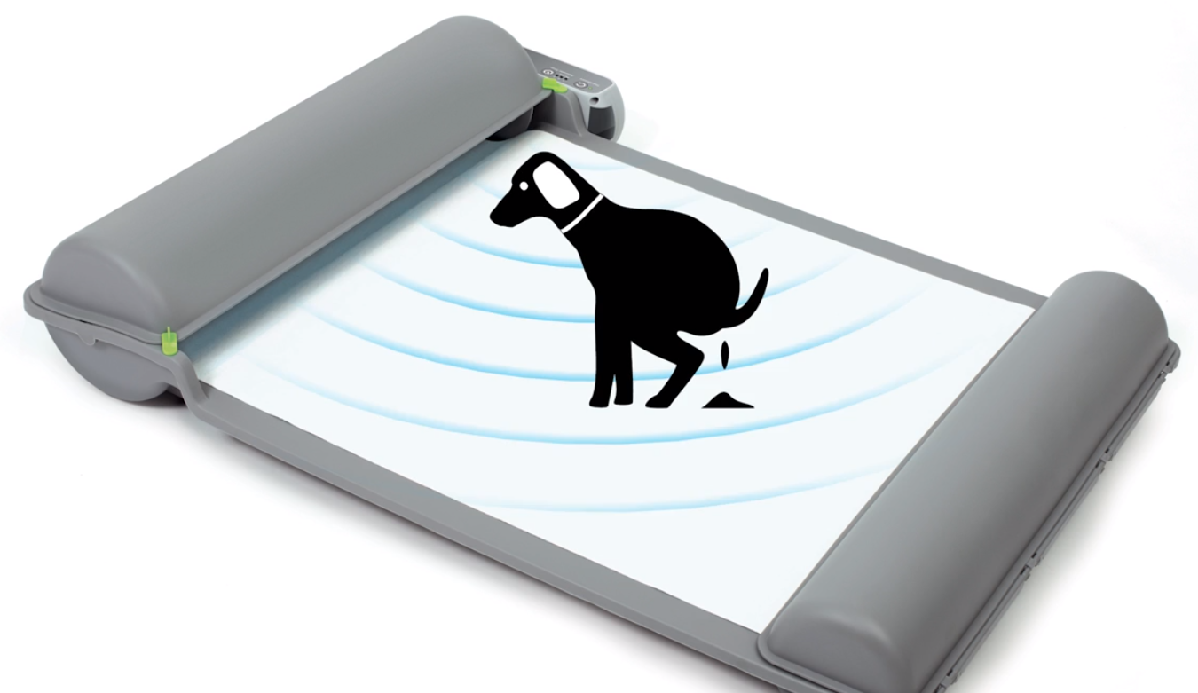
Project Objectives
How dirty is the pad?
Is a dog present?
Notes:
Objective:
Not to redesign the brilliant pad, but to improve the existing product by adding a vision component.
“Our main objective is to determine the feasibility of a camera vision system to the Brilliant Pad, by determining how well we can answer these three questions”
Detect soil level to advance pad only when necessary
Is the pad dirty? If so, how dirty is the pad?
Detect dog presense
Should we prevent the pad from moving?
If the pad needs to advance, but a dog is pooping, want to postpone the pad movement until the dog is done pooping.

Slide 7
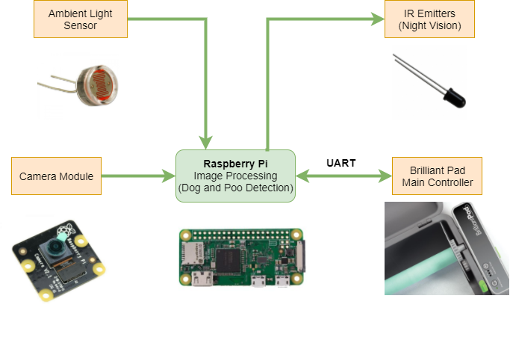
Our Solution
Notes:
The camera module will take a snapshot of the pad every 10 seconds
Then with this image we will turn it into a grayscale image using a minimal threshold of about X%. So if the spot is about X% dark then it will be considered as waste.
If the pad is in a dark room there will be a maximum percentage
Resulting 3 variables sent to the control system.

Slide 8
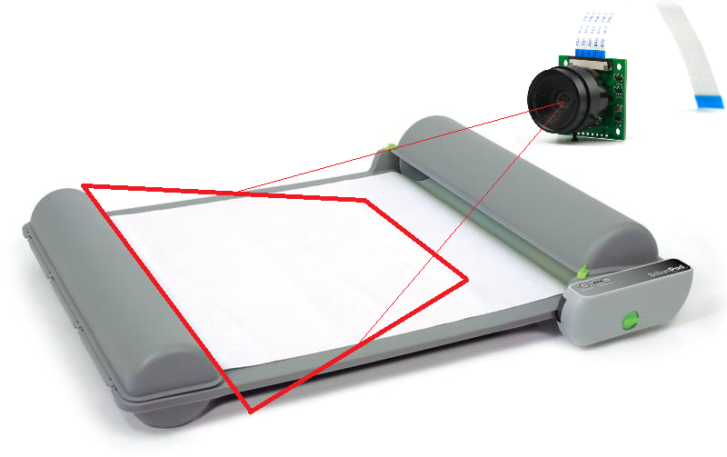
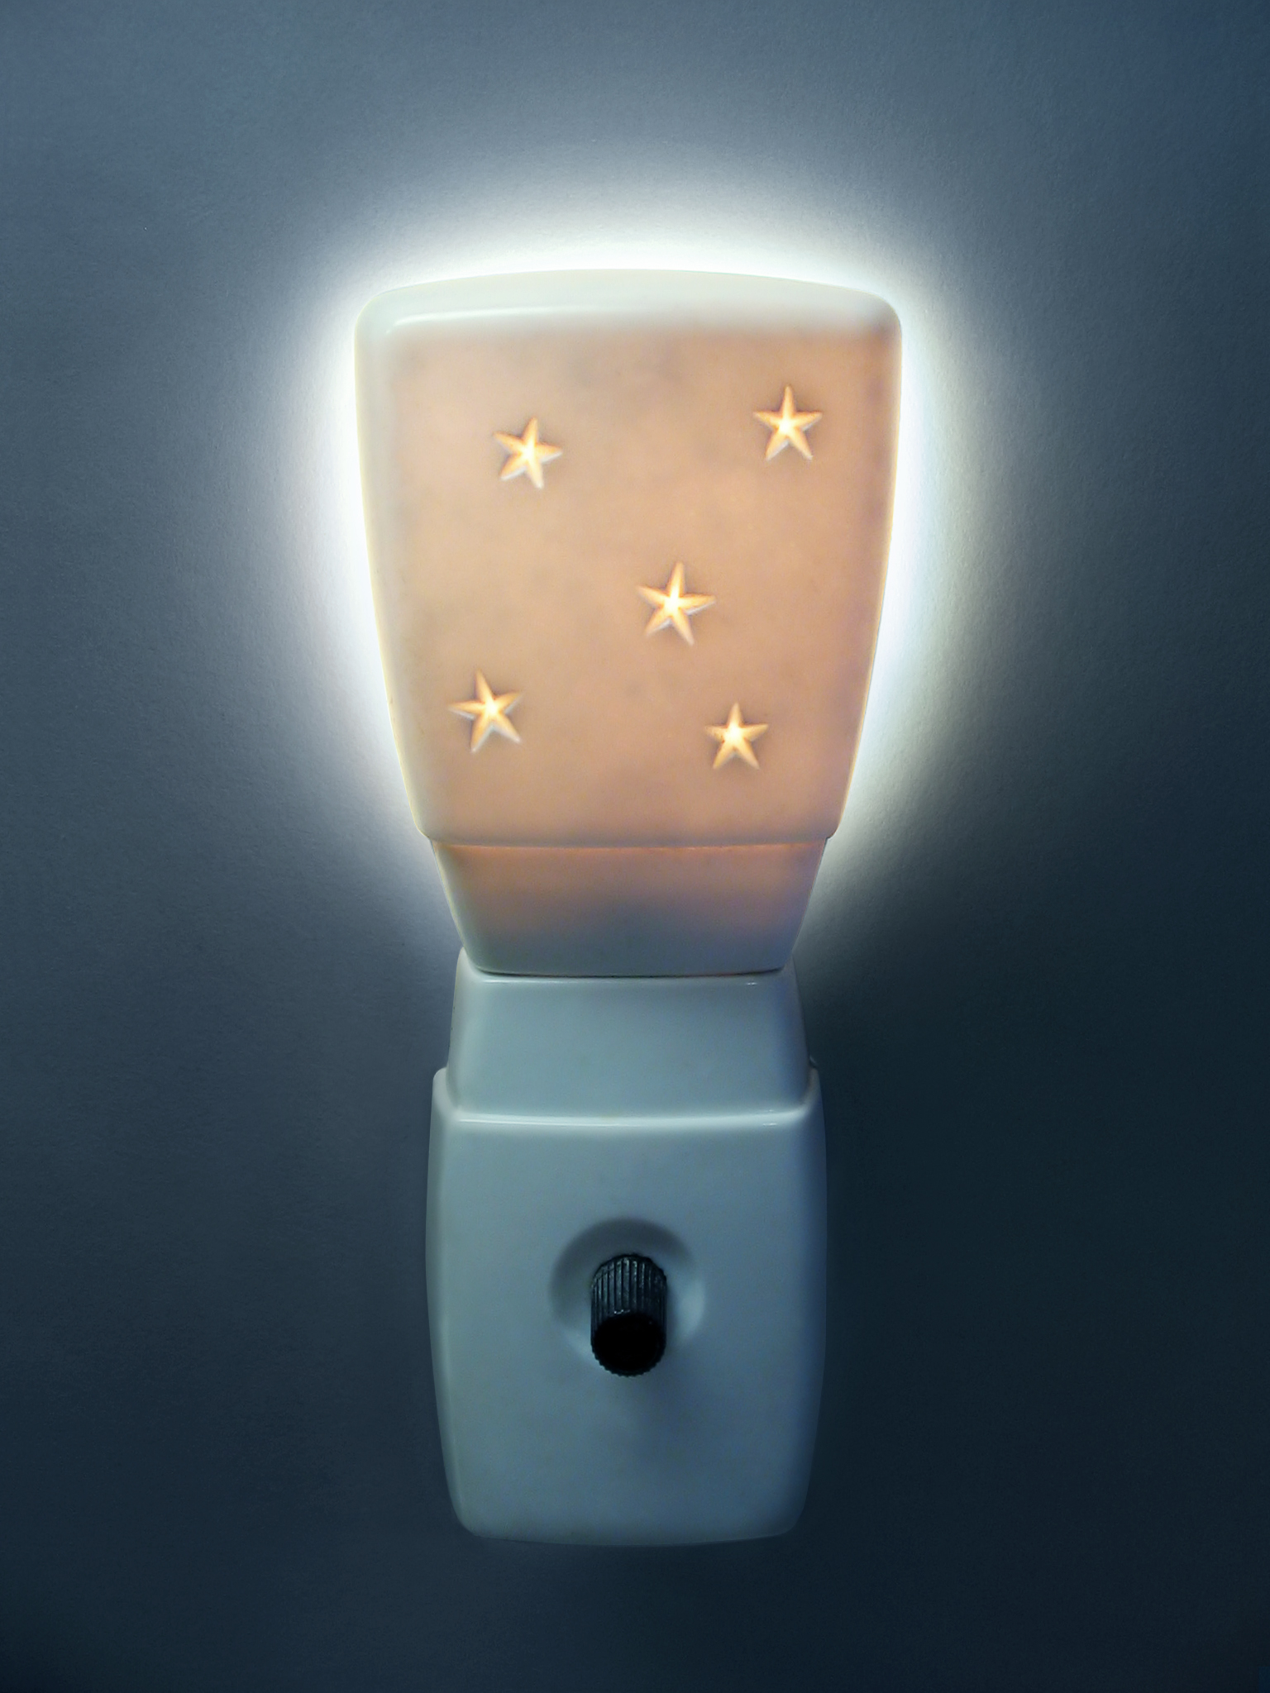
Future Constraints
Notes:
Constraints:
Might not be able to see the full pad area
-camera is angled so the 2D image it sees will be skewed
Consider the time it takes to process the image
- Will it stop rolling up the pad in time when a dog decides to do its business
- commercialized solution: may or may not be a problem

Slide 9
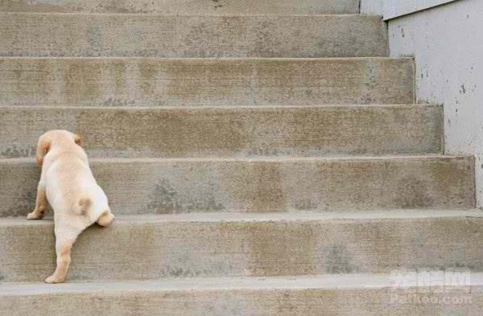
Key Milestones
Key Milestone #1 | Mechanical Prototypes
Key Milestone #2 | Ongoing Documentation
Key Milestone #3 | Analyze and Process Images
Key Milestone #4 [Extra] | Communicate with Brilliant Pad
Notes:
Each key milestone is broken up into smaller, weekly milestones
Most deliverables will be in the form of images or video demonstrations

Slide 10
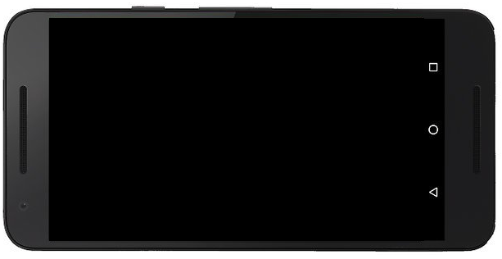
Current Progress: Camera Functionality

Slide 11
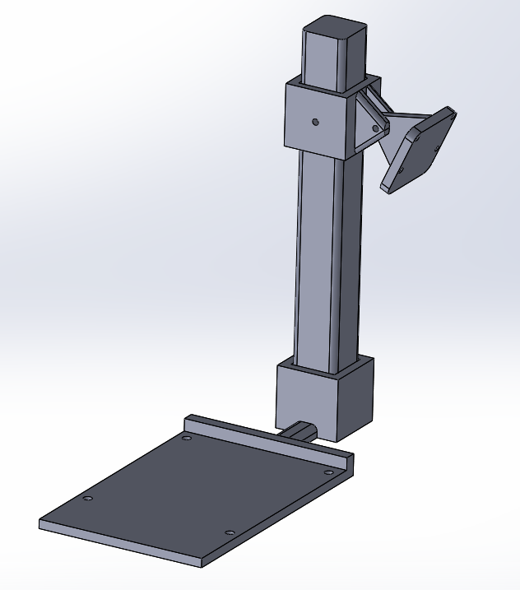
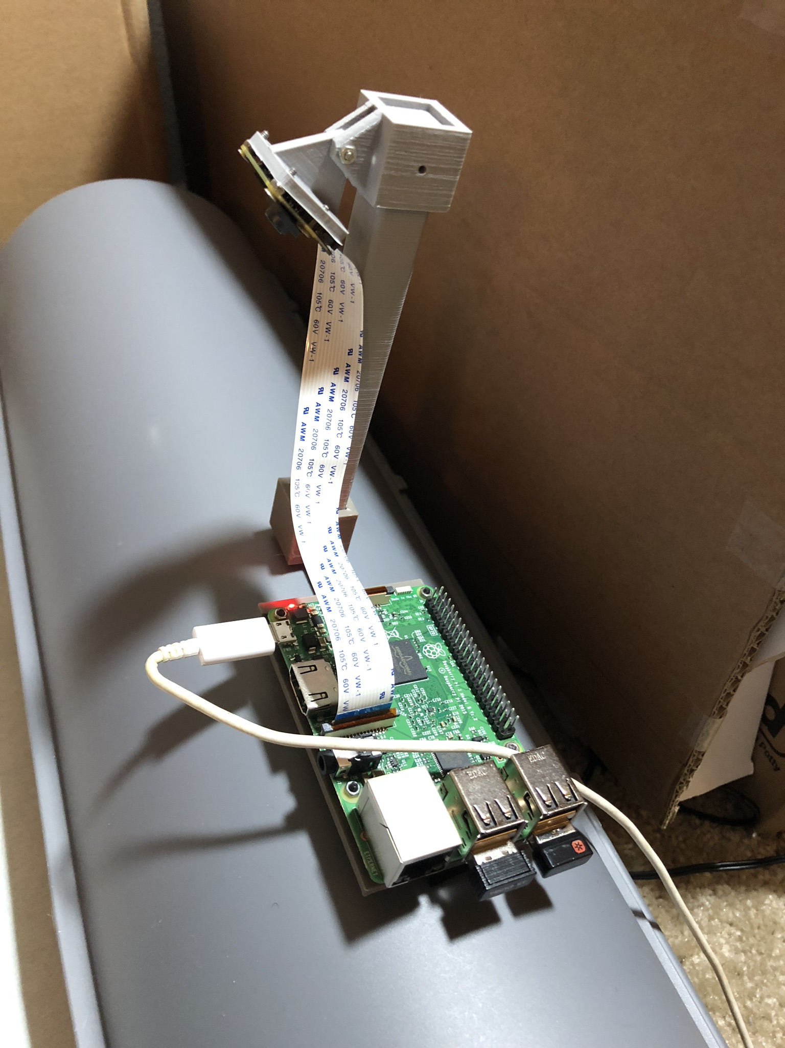
Current Progress: Mechanical CAD
Notes:
First Prototype:
Platform for Raspberry Pi 3
Camera mount with adjustable height and angle
Next Steps:
3D Print and build the design
Test out camera in different positions
Reiterate on design

Slide 12
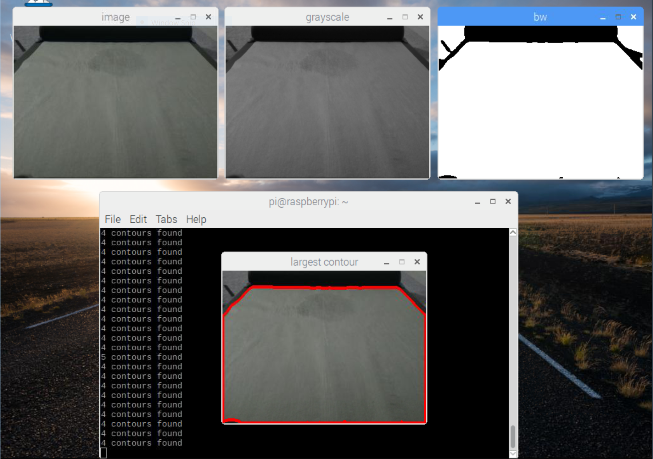
Current Progress: Determining Pad Area

Slide 13
Current Progress: Image Processing
Normal Lighting
Low Light

Slide 14
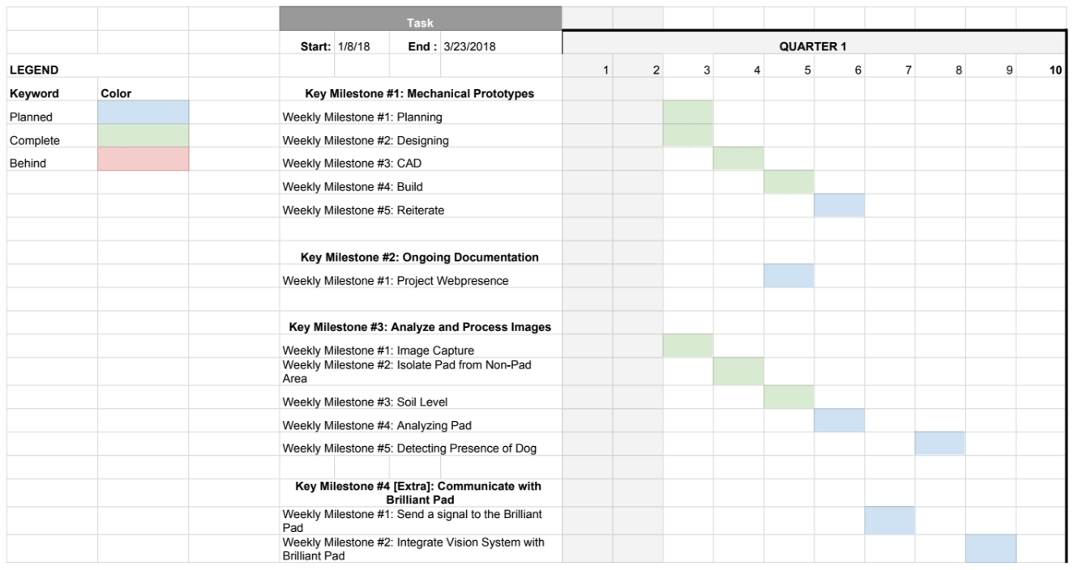
Quarter Plans

Slide 15
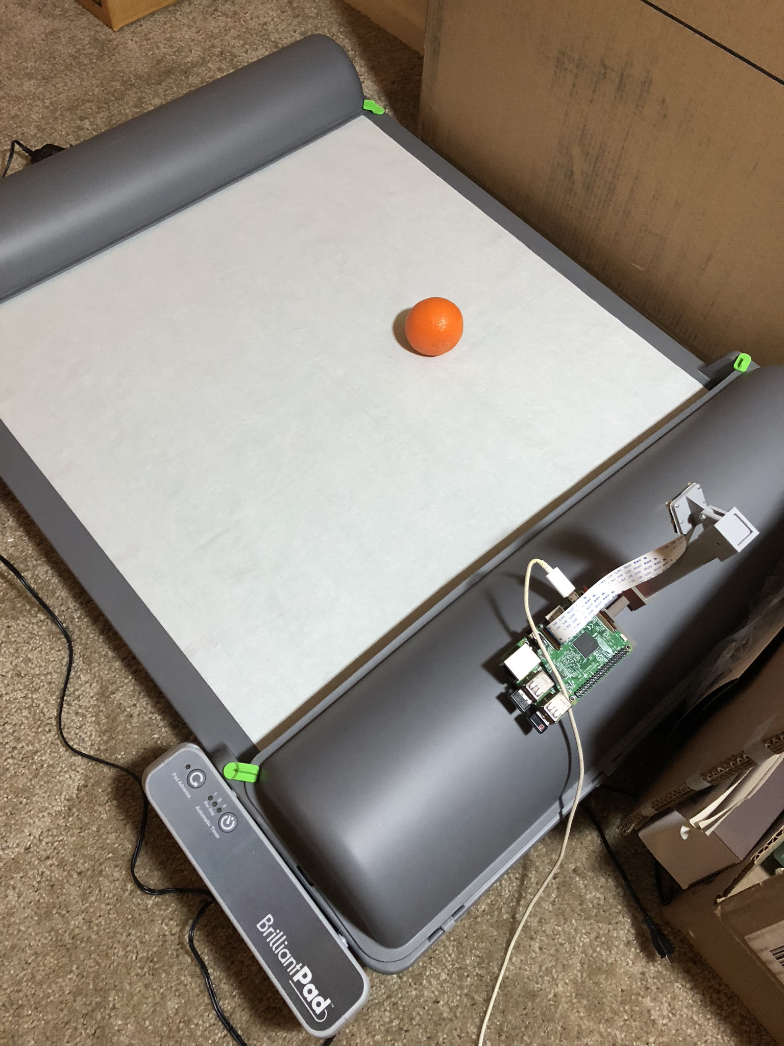
Conclusion
Brilliant Pad currently has a vision system with many flaws.
We aim to improve that system with a more intelligent one
Adding a camera will allow the Brilliant Pad to reliably detect dog and waste presence.

